Slide 1
3_3_3: Meshes
A general mesh is conceptually a collection of triangles – or possibly more general polygons (ie quads). Precisely we can define:
A collection of vertices V0 - … Vn
A collection of faces that reference the indices of these vertices: F0 -> (V0, V1, V2)
Possible additional information on each of the faces, or the vertices of the faces.
Any topological surface, collection of surfaces, or closed “BREP” can be meshed with triangles or more general polygons.
V1
V0
F0
F1
V4
V2
F2
V3

Slide 2
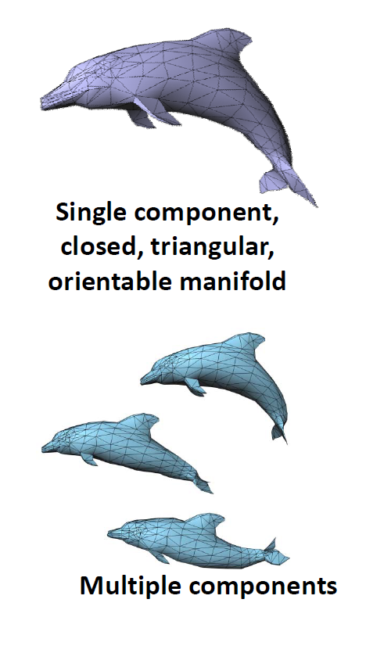
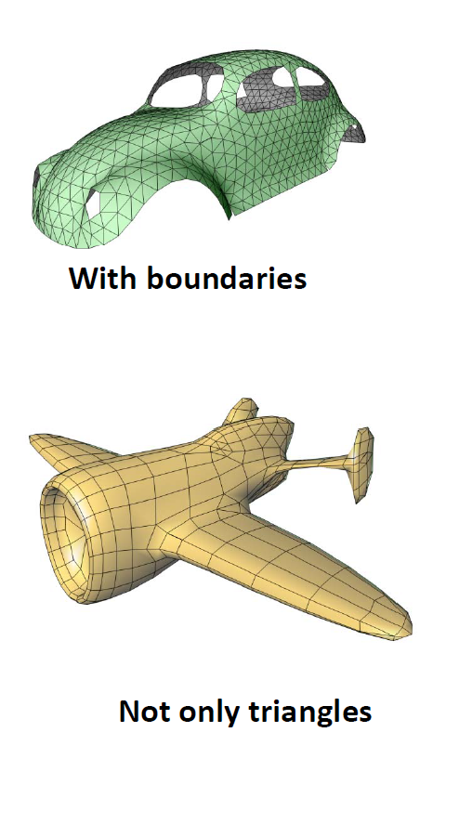
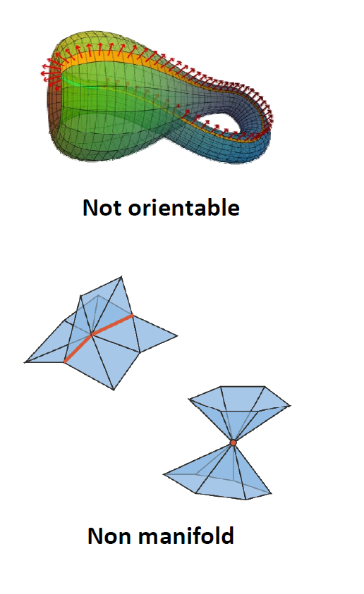

Slide 3
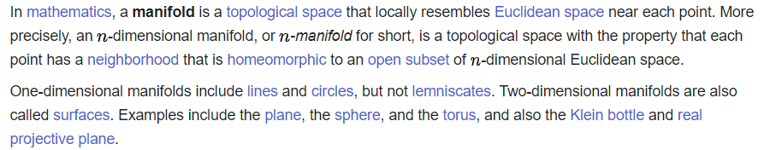
V1
V0
F0
F1
V4
V2
F2
Euler’s formula: V−E+F=2(1−g)
V3
F1
F0
F2

Slide 4
V1
V0
F0
F1
V4
V2
F2
F0: V0, V2, V1
F1: V1, V2, V4
F2: V2, V3, V4
V3
Euler’s formula:
V−E+F=1 // for planar graphs
V−E+F=2(1−g)
V = Vertices
E = Edges
F = Faces
G = Genus (# holes)
5 – 7 + 3 = 1

Slide 5
vn1
V1
vn0
vn4
V0
F0
F1
V4
vn2
V2
F2
vn3
V3
vt1
vt4
F1
F0: V0, V2, V1
F1: V1, V2, V4
F2: V2, V3, V4
F0
F2
vt0
vt2
vt3

Slide 6
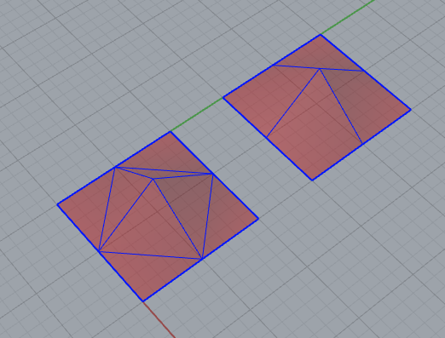
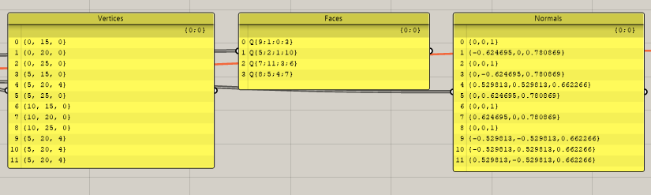
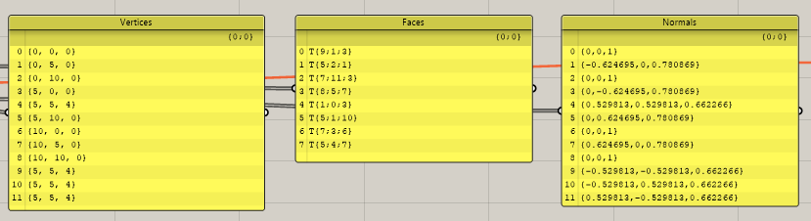
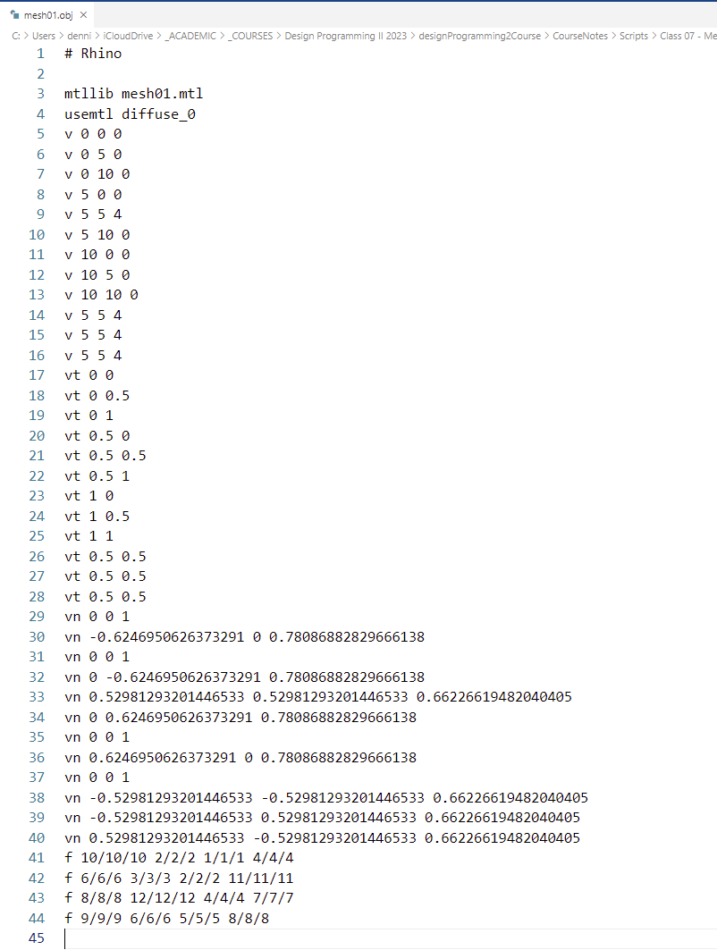
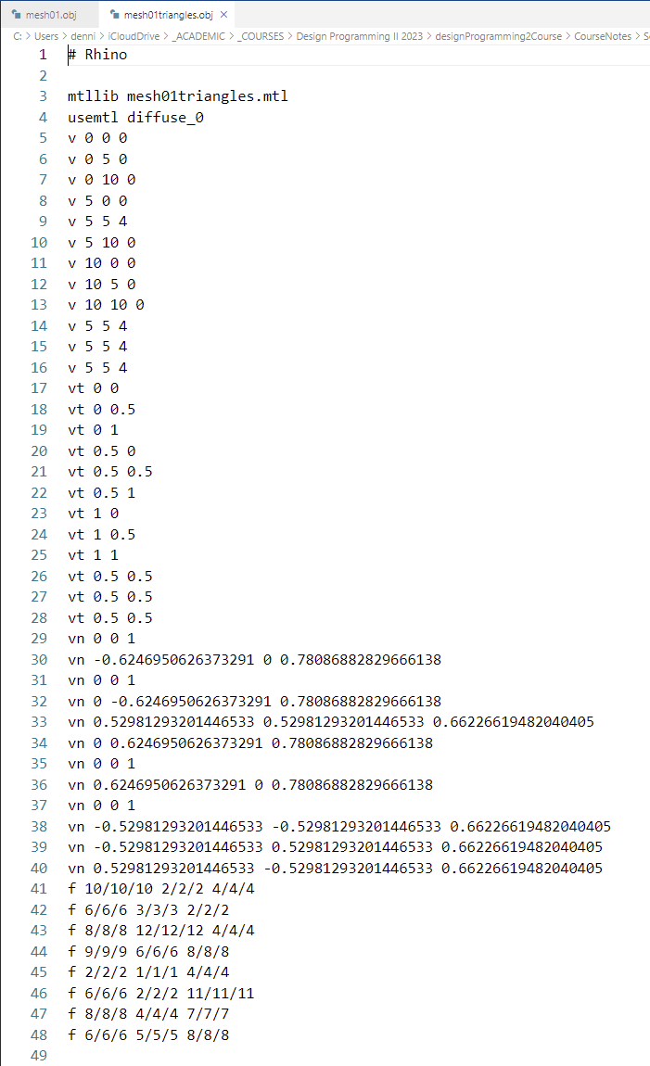

Slide 7
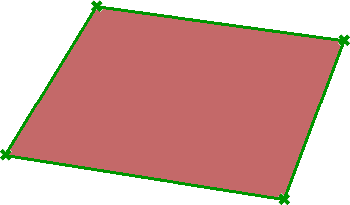
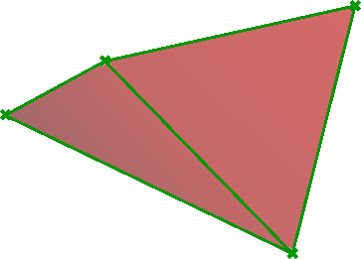
3_3_3: Meshes
Meshes represent a geometry class that is defined by faces and vertices. The mesh data structure basically includes a list of vertex locations, faces that describe vertices connections and normal of vertices and faces. More specifically, the geometry lists of a mesh class include the following.
Mesh geometry lists | Description
Vertices | Of type MeshVertexList - includes a list of vertex locations type Point3f.
Normals | Of type MeshVertexNormalList - includes a list of normals of type Vector3f.
Faces | Of type MeshFaceList - includes a list of normals of type MeshFace.
FaceNormals | Of type “MeshFaceNormalList” - includes a list of normals of type Vector3f.
Create mesh objects:
You can create a mesh from scratch by specifying vertex locations, faces and compute the normal as in the following examples.
//Create a simple rectangular mesh that has 1 face //Create a new instance of a mesh Rhino.Geometry.Mesh mesh = new Rhino.Geometry.Mesh(); //Add mesh vertices mesh.Vertices.Add(0.0, 0.0, 0.0); //0 mesh.Vertices.Add(5.0, 0.0, 0.0); //1 mesh.Vertices.Add(5.0, 5.0, 0.0); //2 mesh.Vertices.Add(0.0, 5.0, 0.0); //3 //Add mesh faces mesh.Faces.AddFace(0, 1, 2, 3); //Compute mesh normals mesh.Normals.ComputeNormals(); //Generate any additional mesh data mesh.Compact();
//Create simple triangular mesh that has 2 faces //Create a new instance of a mesh Rhino.Geometry.Mesh mesh = new Rhino.Geometry.Mesh(); //Add mesh vertices mesh.Vertices.Add(0.0, 0.0, 0.0); //0 mesh.Vertices.Add(5.0, 0.0, 2.0); //1 mesh.Vertices.Add(5.0, 5.0, 0.0); //2 mesh.Vertices.Add(0.0, 5.0, 2.0); //3 //Add mesh faces mesh.Faces.AddFace(0, 1, 2); mesh.Faces.AddFace(0, 2, 3); //Compute mesh normals mesh.Normals.ComputeNormals(); //Generate any additional mesh data mesh.Compact();
>>
>>

Slide 8
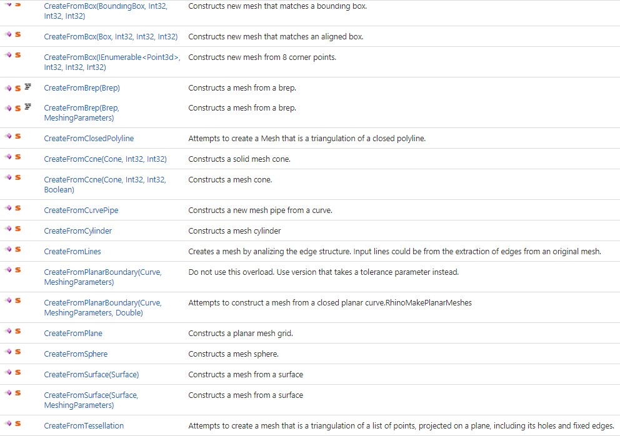
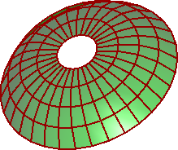
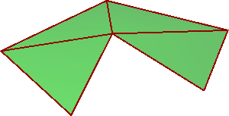
Creating meshes
The Mesh class includes many CreateFrom static methods to create a new mesh from various other geometry. Here is the list with description as it appears in the RhinoCommon help.
Here are a couple examples to show how to create a mesh from a brep and a closed polyline.
//Set mesh parameters to default var mp = MeshingParameters.Default; //Create meshes from brep var newMesh = Mesh.CreateFromBrep(brep, mp);
//Create a new mesh from polyline var newMesh = Mesh.CreateFromClosedPolyline(pline);
>>
>>

Slide 9
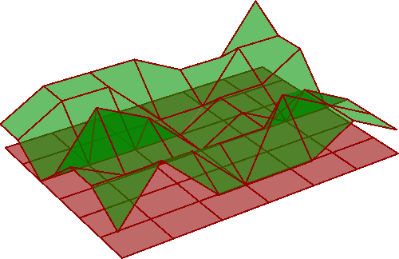
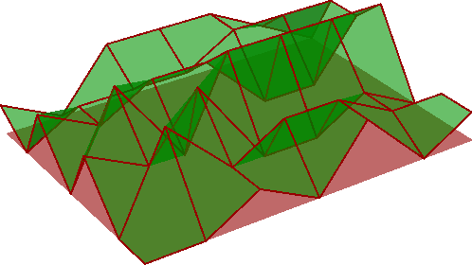
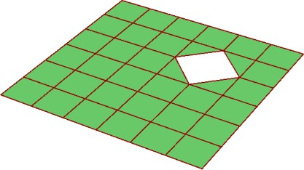
Navigate mesh geometry and topology:
You can navigate mesh data using Vertices and Faces properties. The list of vertices and faces are stored in a collection class or type with added functionality to manage the list efficiently.
Vertices list for example, is of type MeshVertexList. So if you need to change the locations of
mesh vertices, then you need to get a copy of each vertex, change the coordinates, then reassign in the vertices list. You can also use the Set methods inside the MeshVertexList class to change vertex locations.
The following example shows how to randomly change the Z coordinate of a mesh using two different approaches. Notice that mesh vertices use a Point3f and not Point3d type because mesh vertex locations are stored as a single precision floating point.
Change the location of mesh vertices by assigning the new value to the Vertices’ list
//Change mesh vertex location int index = 0; Random rand = new Random(); foreach (Point3f loc in mesh.Vertices) { Point3f newLoc = loc; newLoc.Z = rand.Next(10) / 3; mesh.Vertices[index] = newLoc; index = index + 1; }
Change the location of mesh vertices using the SetVertix method
Mesh mesh = … // from input //Create a new instance of random generator Random rand = new Random(); for (int i = 0; i <= mesh.Vertices.Count - 1; i++){ //Get vertex Point3f loc = mesh.Vertices[i]; loc.Z = rand.Next(10) / 3; //Assign new location mesh.Vertices.SetVertex(i, loc); }
>>
>>
Here is an example that deletes a mesh vertex and all surrounding faces
Delete mesh faces randomly
Mesh mesh = … // from input int index = 32; //Remove a mesh vertex (make sure index falls within range) if (index >= 0 & i < mesh.Vertices.Count) { mesh.Vertices.Remove(index, true); }
>>

Slide 10
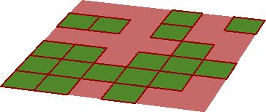
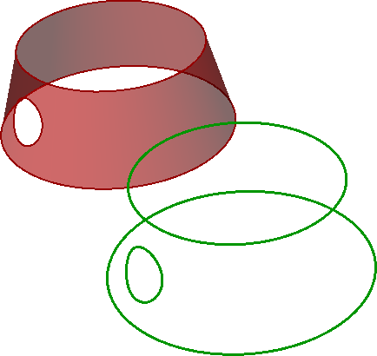
Navigate mesh geometry and topology
You can also manage the Faces list of a mesh. Here is an example that deletes about half the faces randomly from a given mesh.
Delete mesh faces randomly
List<int> faceIndices = new List<int>(); int count = mesh.Faces.Count; //Create a new instance of random generator Random rand = new Random(); for (int i = 0; i <= count - 1; i += 2){
>>
int index = rand.Next(count); faceIndices.Add(index);
}
//delete duplicate indexes
List<int> distinctIndices = faceIndices.Distinct().ToList();
//delete faces mesh.Faces.DeleteFaces(distinctIndices);
Meshes keep track of the connectivity of the different parts of the mesh. If you need to navigate related faces, edges or vertices, then this is done using the mesh topology. The following example shows how to extract the outline of a mesh using the mesh topology.
Mesh topology example: extract the outline of a mesh
// Get the mesh's topology Rhino.Geometry.Collections.MeshTopologyEdgeList meshEdges = mesh.TopologyEdges; List<Line> lines = new List<Line>(); // Find all of the mesh edges that have only a single mesh face for (int i = 0; i <= meshEdges.Count - 1; i++) { int numOfFaces = meshEdges.GetConnectedFaces(i).Length; if ((numOfFaces == 1)) { Line line = meshEdges.EdgeLine(i); lines.Add(line); } }
>>

Slide 11
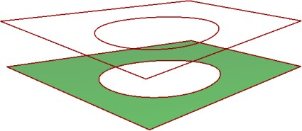
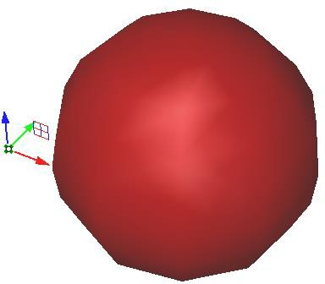
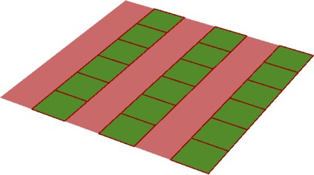
Mesh methods
Once a new mesh object is created, you can edit and extract data out of that mesh object. The following example extracts naked edges out of some input mesh.
Extract the outline of a mesh
Mesh mesh = … // from input //Declare an array of polylines Polyline[ ] naked_edges = { }; //Create a new mesh from polyline nakedEdges = mesh.GetNakedEdges();
Test if a given point is inside a closed mesh
Mesh mesh = … // from input Point3d pt = … // from input //Test if the point is inside the mesh mesh.IsPointInside(pt, tolerance, true);
>>
>>
Delete every other mesh face, then split disjoint meshes
Mesh mesh = … // from input List<int> faceIndeces = new List<int>(); //Loop through faces and delete every other face for (int i = 0; i <= mesh.Faces.Count - 1; i += 2) { faceIndeces.Add(i); } //delete faces mesh.Faces.DeleteFaces(faceIndeces); //Split disjoint meshes Mesh[ ] meshArray = mesh.SplitDisjointPieces();
>>

Slide 12
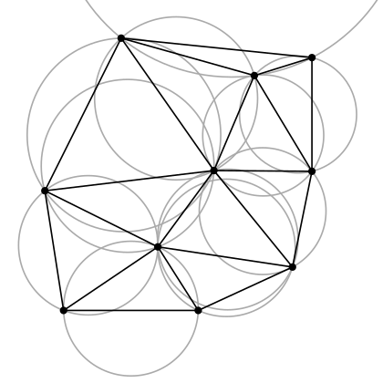
Delaunay Triangulation
A Delaunay Triangulation in a plan is a mesh such that no vertex is contained in the circle circumscribed by the 2 points of any given triangle.

Slide 13
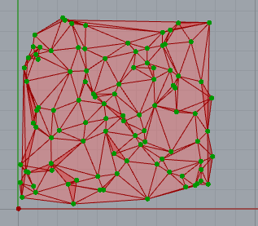
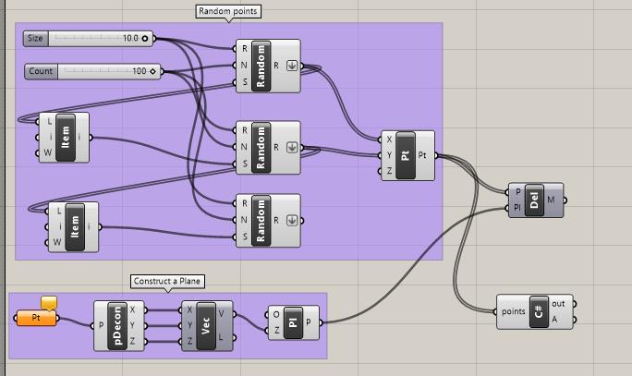
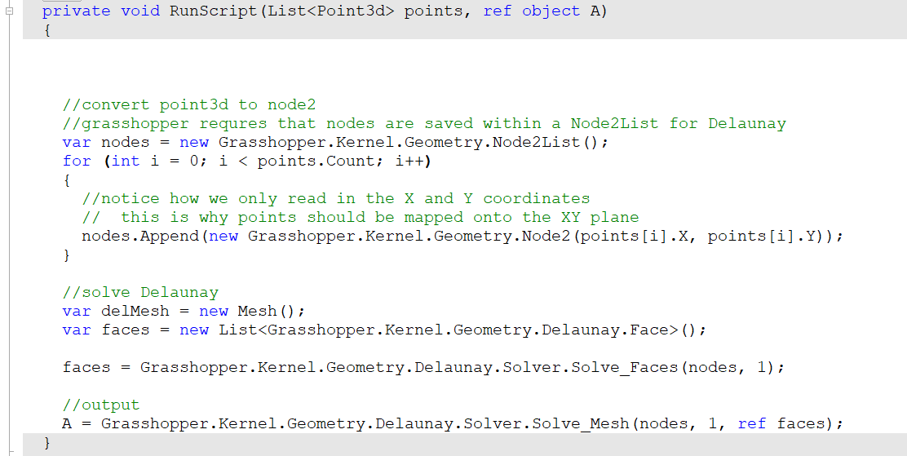
Delaunay Triangulation
>>

Slide 14
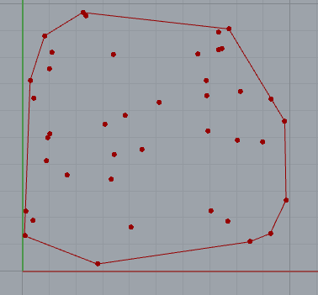
Convex Hull
>>

Slide 15
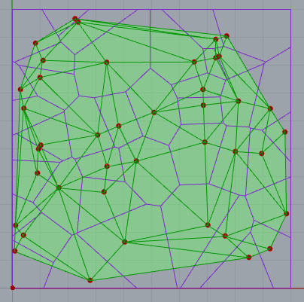
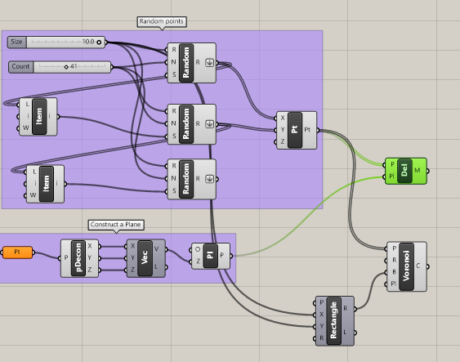
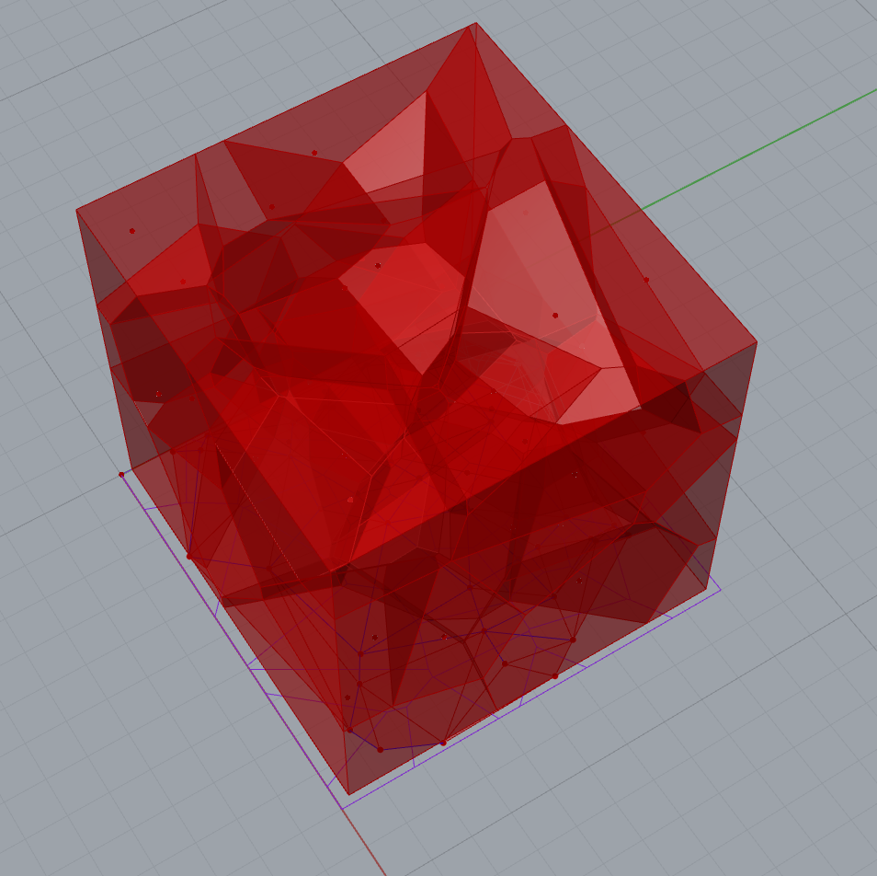
Vornoi
>>

